Slide 1
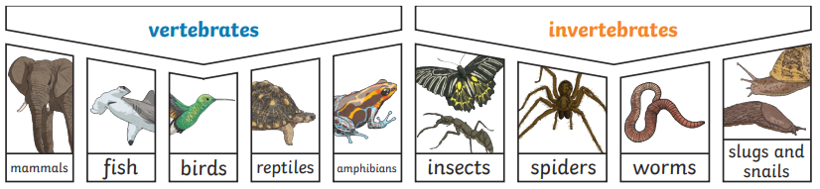
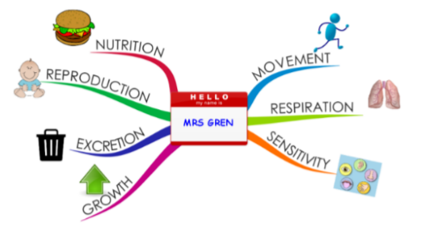
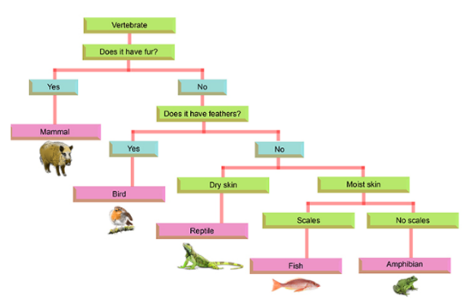
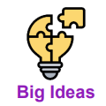
Year 4 Term 1 Science
Living things and their habitats
Vocabulary
Classification |  | environment
Category |  | urbanisation
Vertebrate |  | deforestation
Invertebrate |  | pollution
Conservation |  | Climate change
Already, I can…
… identify that most living things live in habitats to which they are suited and describe how different habitats provide for the basic needs of different animals and plants and how they depend on each other. … identify and name a variety of plants and animals in their habitats, including microhabitats.
Can I…
Can I classify animals? Can I use classification diagrams and group using careful observations? Can I explore what types of plants and animals live in our local area? Can I use observation and tools such as magnifying glasses? Can I explore the features of our local environment? Can I use my observations to identify how things change? Can I explore how humans can have positive and negative impacts on the environment? Can I use scientific evidence? Can I explain how we can develop the local environment to protect living things? Can I suggest answers to questions using scientific evidence? Can I recall and revisit my learning?
My sticky knowledge…
Big Ideas
Living and non-living things can be grouped in a variety of ways.
Living things depend on each other and the environment; humans can have both a positive and negative impact.

Slide 2
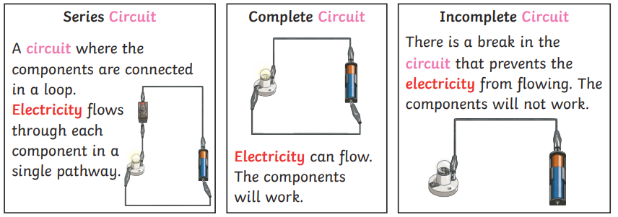
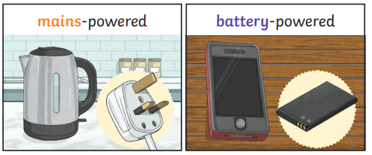
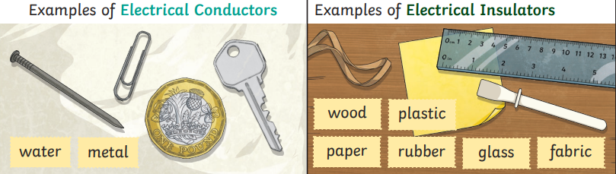
Year 4 Term 2 Science
Electricity
Vocabulary
appliances |  | energy
battery |  | fuel
bulb |  | generate
buzzer |  | insulator
circuit |  | mains
component |  | motor
cell |  | power
conductor |  | source
current |  | switch
device |  | wires
electricity
Already, I can…
… notice that light is reflected from surfaces. … explain that light is a form of energy and travels.
Can I…
Can I explain where electricity comes from and what it is used for? Can I make systematic and careful observations to classify and group? Can I construct a simple series circuit? Can I set up a simple, practical investigation and verbally report my findings? Can I explain how a switch works? Can I use straightforward scientific evidence to answer questions? Can I explore what material is the best conductor of electricity? Can I set up a comparative test and use my results to draw simple conclusions? Can I explain what components are needed to make a working circuit? Can I use scientific language to design diagrams and create functional objects? Can I revisit and recall my learning?
My sticky knowledge…
Big Ideas
Living and non-living things can be grouped in a variety of ways.
Energy makes things happen and can be seen by its effects (light, sound, electricity); it can be transferred but is not used up.

Slide 3
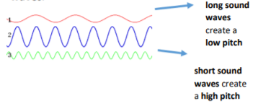
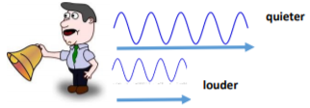
Year 4 Term 3 Science
Sound
Vocabulary
sound
vibrations
medium
volume
distance
decrease
insulator
energy
sound wave
source
pitch
Already, I can…
… explain that hearing is one of my five senses. … explain that sounds can be made in various ways.
Can I…
Can I identify how sounds are made? Can I make careful observations? Can I find patterns between the strength of vibrations and the volume of a sound? Can I set up a comparative test and draw simple conclusions? Can I explore what happens to sound as the distance away increases? Can I conduct a fair test with control variables? Can I explore which material provides the best insulation against sound? Can I conduct a fair test and create a results table? Can I explore how the features of an object affect the pitch of the sound it makes? Can I draw conclusions using scientific language? Can I recall my learning?
My sticky knowledge…
Big Ideas
Energy makes things happen and can be seen by its effects. Energy can be transferred but is not used up.

Slide 4
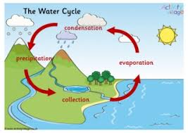
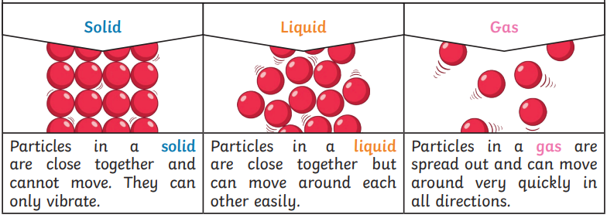
Year 4 Term 4 Science
States of Matter
Vocabulary
collection
condensation
cooling
evaporation
freezing
gas
heating
liquid
melting
precipitation
solid
solidifying
steam
Water Cycle
water vapour
Already, I can…
… describe the simple physical properties of a variety of everyday materials. … find out how the shapes of solid objects made from some materials can be changed. … compare and group together a variety of everyday materials.
Can I…
Can I explore how many states of matter there are? Can I group and classify? Can I investigate whether temperature can change the state of an object? Can I set up simple comparative and fair tests? Can I explore whether all liquids can be frozen to become solids? Can I make careful observations? Can I recall the stages of the Water Cycle? Can I create a scientific model? Can I explore what affects the rate of evaporation? Can I gather and record data in a table and line graph? Can I recall my learning?
My sticky knowledge…
Big Ideas
There is a relationship between structure and function.
All matter on Earth exists in one of three states: solid, liquid, gas and the state of matter can change.
Energy makes things happen and can be seen by its effects; it can be transferred (but is not used up).

Slide 5
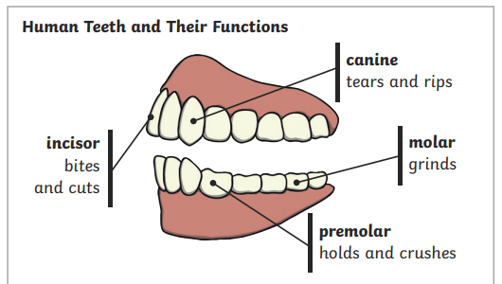
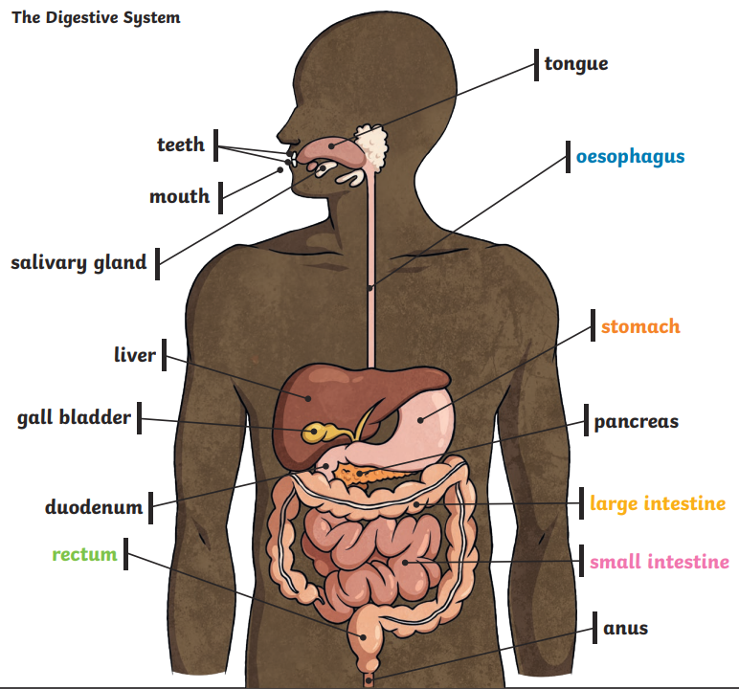
Year 4 Term 5 Science
Animals including Humans
Vocabulary
teeth
Digestive system
mouth
tongue
stomach
energy
incisor
canine
molar
oesophagus
Small intestine
Large intestine
Already, I can…
… identify and name a variety of common animals that are carnivores, herbivores and omnivores. … identify that animals, including humans, need the right types and amount of nutrition, and that they cannot make their own food; they get nutrition from what they eat.
Can I…
Can I know the different types of teeth in humans and their simple functions? Can I set up simple practical enquiries? Can I know the types of teeth in different animals and their simple functions? Can I recognise when and how secondary sources might help us to answer questions? Can I explain what happens to our food when we eat? Can I create a model? Can I know the simple functions of the basic parts of the digestive system in humans? Can I set up a simple practical enquiry? Can I explain the role of food chains? Can I sort and classify? Can I revisit my learning?
My sticky knowledge…
Big Ideas
There is a relationship between structure and function.
Living and non-living things can be grouped in a variety of ways.
Living things have characteristics and requirements for life, growth and health.
Living things depend on each other and on the environment; humans can have both a positive and negative impact.

